Slide 1
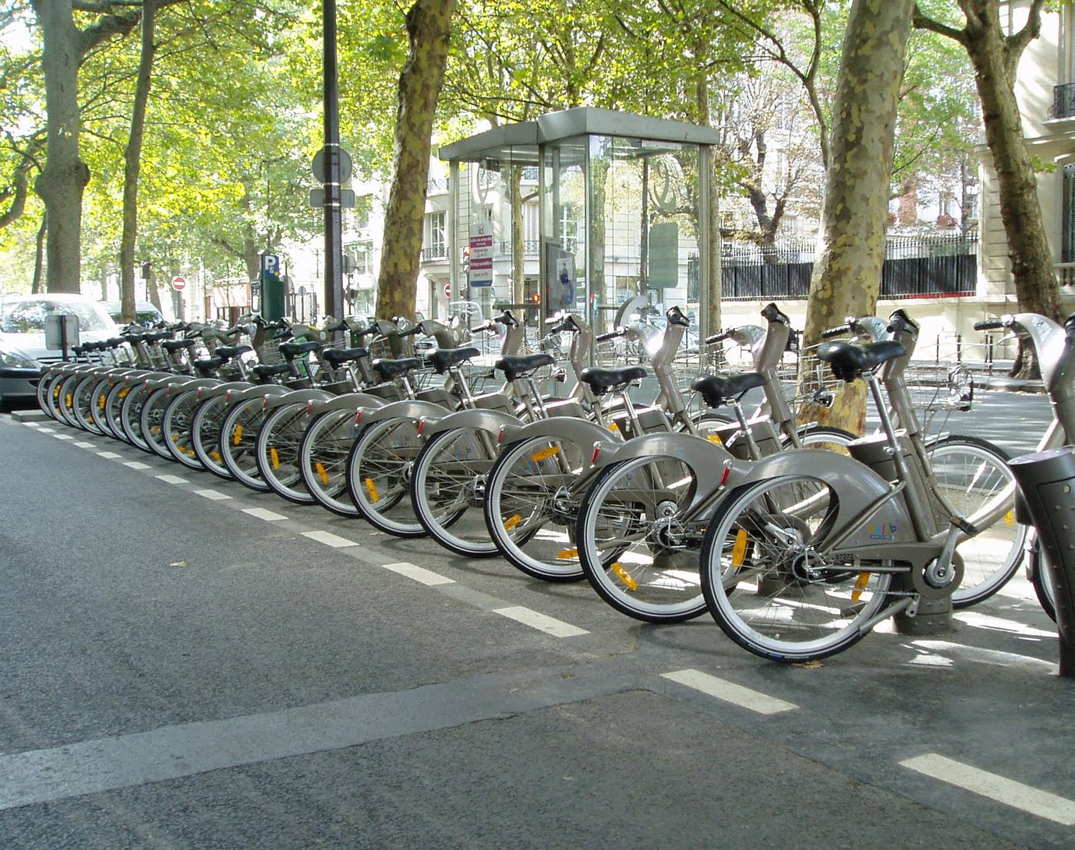
Applied Data Science with R Bikeshare Project
Owen Randolph
9/11/2023

Slide 2
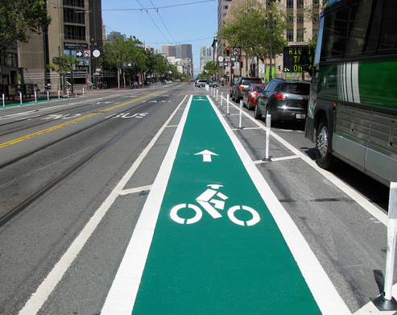
Outline
Executive Summary
Introduction
Methodology
Results
Conclusion
Appendix

Slide 3
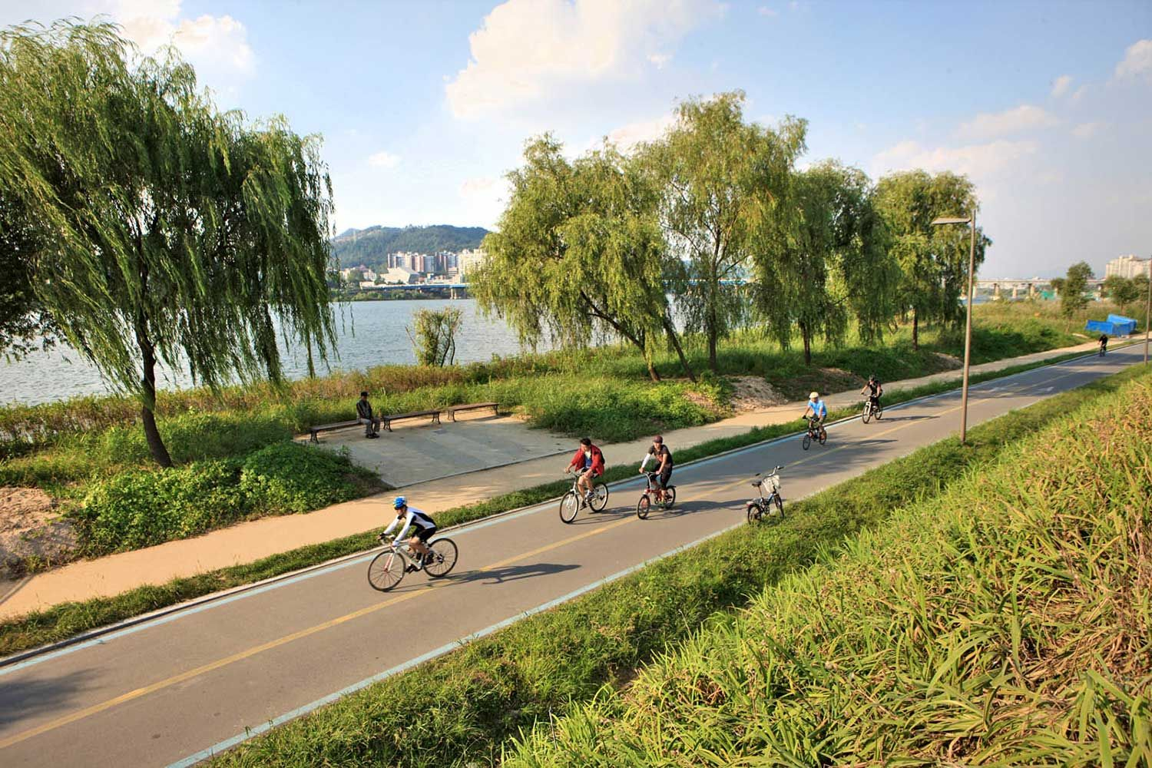
Executive Summary
The aim of the project is to analyze the correlation between weather and the demand for bike-sharing in cities to predict the number of bikes based on weather conditions
A regression model is trained with data collected from multiple sources
Positive correlation between demand and temperature
Negative correlation between humidity and rainfall

Slide 4
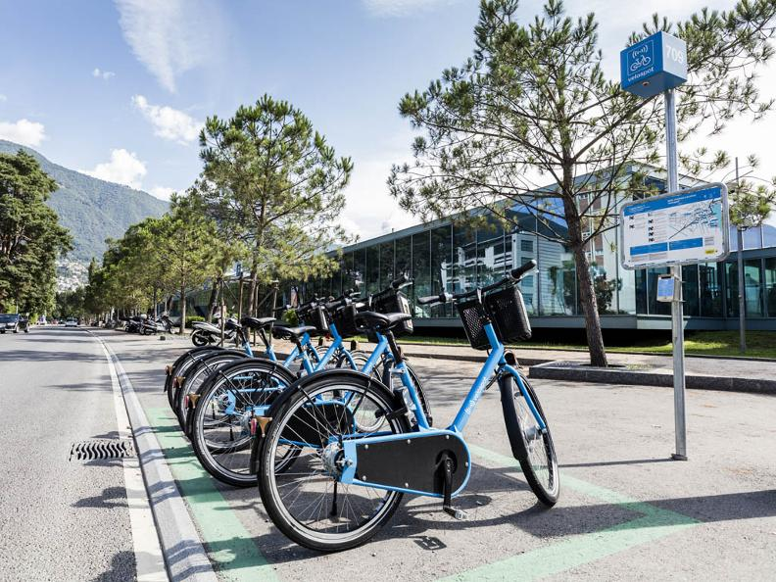
Introduction
The project analyses the relationship between weather conditions and bike-sharing demand in different cities
Different regression models are evaluated, and an interactive map shows estimated demand for bikes associated with different weather conditions

Slide 5
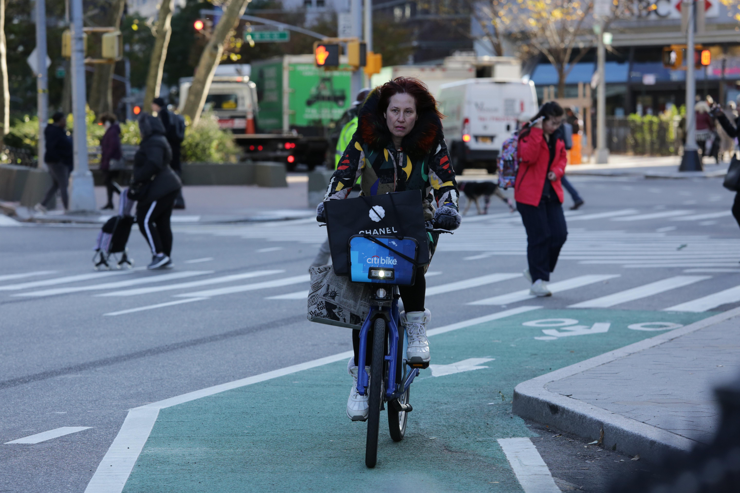
Methodology
Perform data collection
Perform data wrangling
Perform exploratory data analysis (EDA) using SQL and visualization
Perform predictive analysis using regression models
How to build the baseline model
How to improve the baseline model
Build a R Shiny dashboard app

Slide 6
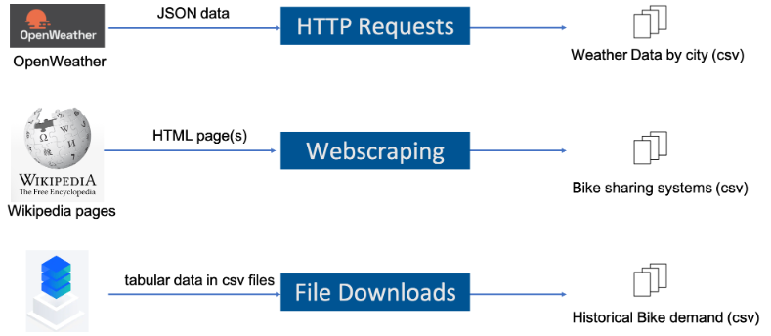
Data Collection
Three data sets are required to perform ESA and build our model, each with a different method of collection:

Slide 7
Data Wrangling using stringr
Standardizing column names
Removing undesired reference links in City Name and System columns
Extracting numeric values using regex

Slide 8
Data Wrangling using dplyr
Detecting & handling missing values in Temperature column
Creating indicator variables for categorical variables
Normalizing the data

Slide 9
Exploratory Data Analysis with SQL
Using 'RODBC' library the following is queried and examined:
Specific information related to bike-sharing systems, weather and the cities where the bike sharing systems are located
The purpose is to execute record counts, filter data, and aggregate different tables from various datasets
Insights are revealed about the number of rented bikes in relation to weather conditions and locations.

Slide 10
EDA with Data Visualization
Scatter plots are used to examine trends in correlation between:
Data and Time variables to find patterns across temperature, seasons, weekdays, months, and hours
Temperature by season
Histograms are used to plot density in order to understand frequency of bike demand segments

Slide 11
Multiple Regression Analysis
Data is split into Training & Testing Sets
Predictive analysis is done by different regression models
Baseline Linear Regression model: weather related indicators versus all variables as predictors
LRM with higher-order polynomial
LRM with higher-order polynomial and interaction terms
LRM with Lasso, Ridge, and Elastic Net penalties
Evaluation using RMSE and RSQ

Slide 12
Build a R Shiny dashboard
An interactive dashboard using R Shiny is built for visualization. It is comprised of:
A dropdown list with the cities of: Seoul, Suzhou, Paris, New York, and London
A map with circle markers whose size and color depend on the size of bike demand prediction for the next 5 days.
Each of the locations contains 3 static plots:
Temperature forecasts for the next 5 days
Prediction for Bike-sharing demand
Relationship between humidity and bike rental demand

Slide 13

Results
Exploratory data analysis results
Predictive analysis results
A dashboard demo in screenshots

Slide 14

EDA with SQL

Slide 15
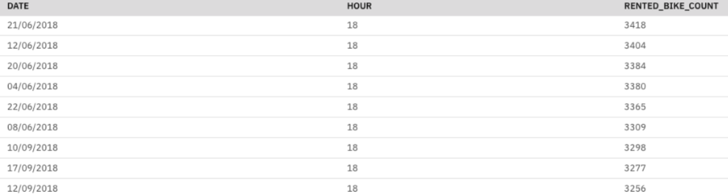
Busiest Bike Rental Times
The busiest time of day is the 18th hour, 6:00 PM – 7:00 PM, during the months of June and September.

Slide 16
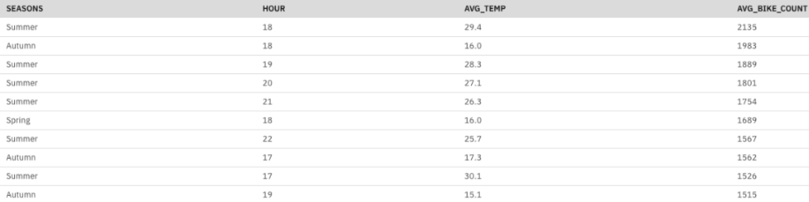
Hourly Popularity and Temperature by Season
The evening hours tend to show the highest demand for bikes, particularly during the spring, summer and autumn.
As the temperatures are warmer in summer, riders tend to be more willing to rent later in the evening.

Slide 17
Weather Seasonality
As expected, demand for bike rentals is strongly correlated with temperature.
There is also a negative correlation between precipitation and rental numbers.
Other weather variables do not present clear patterns.

Slide 18
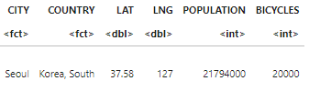
Bike-sharing info in Seoul
Seoul’s bike sharing program has one bike available for roughly every 1000 people

Slide 19
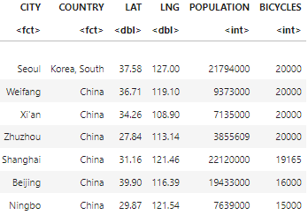
Cities Similar to Seoul
Numerous Chinese cities have similar numbers of rental bikes in their bike share programs.
However, the sizes of these cities vary widely, showing higher ratios of bikes per capita.

Slide 20
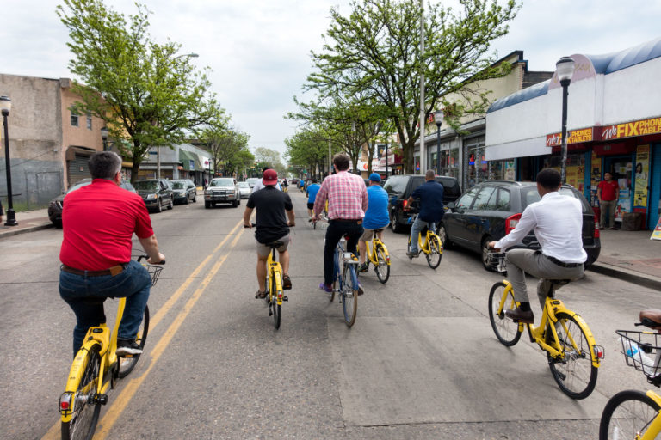
EDA with Visualization

Slide 21
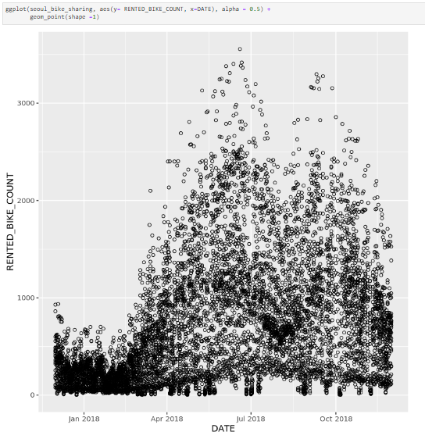
Bike Rental vs. Date
Rentals peaked in June and had very high usage in September also.
The lowest number of bikes rented occurred between December and March, when it's the coldest.
Rental trends were more stably low during these months, but usage was more spread out during the summer and fall months.

Slide 22
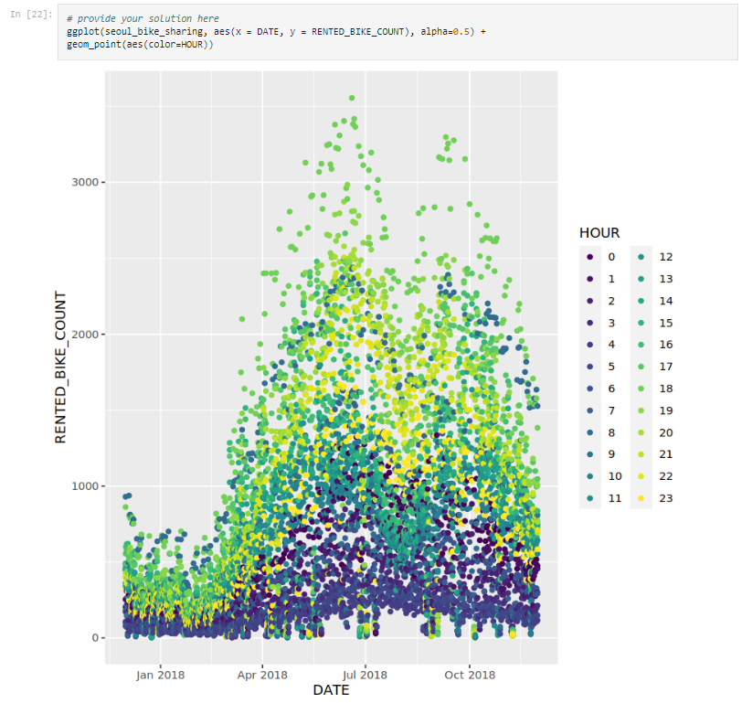
Bike rental vs. Datetime
In the summer, the highest numbers of bikes are rented in the evening hours.
Nighttime before midnight: second most popular time.
Throughout the year, it appears that the very early morning hours are when the fewest bikes are rented out.
The single blue dots of high usage in the warm months, and of highest usage in the cold months:
Bikes being used for morning work commutes; likewise, there are similar numbers of green dots, which are the evening commute bikes.

Slide 23
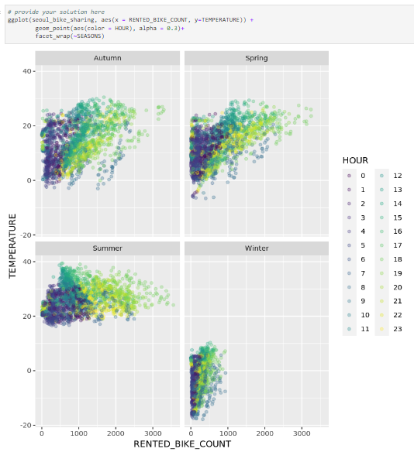
Rented Bike Count vs. Temperature
People tend to stop renting bikes when the temperature goes above 30 degrees.
The ideal temperature for bike rentals in between 10 and 30 degrees.
Although there are fewer rentals during the winter, the temperature has a direct impact on the number of rentals: warmer temperatures yield higher numbers.

Slide 24
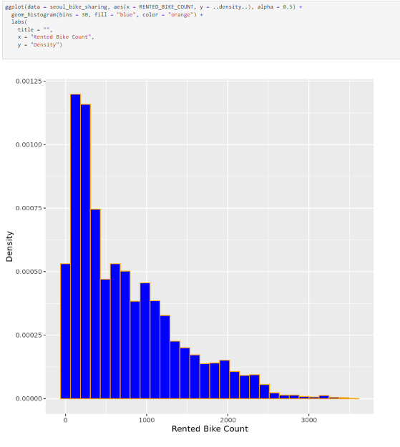
Bike Rental Histogram
Often low numbers of bikes rented. The mode is about 200-300 bikes at a time.
The drop off in bike count includes little bumps in the rental numbers, indicating possible subgroups of the dataset.
The data being skewed to the right indicates that there are occasions when very high numbers of bikes are rented.

Slide 25
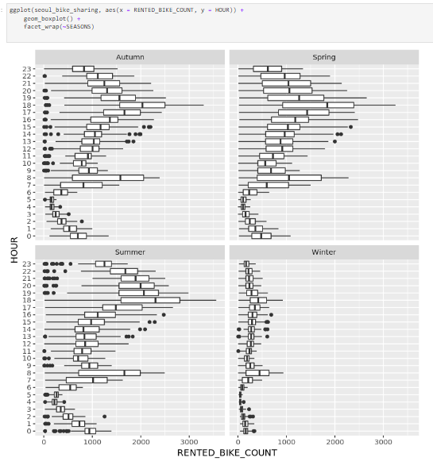
Rented Bike Count by Hour grouped by Season
Although the overall scale of bike rental counts changes with the seasons, key features remain very similar.
For example, peak demand times are the same across all seasons, at 8 am and 6 pm

Slide 26

Predictive Analysis

Slide 27
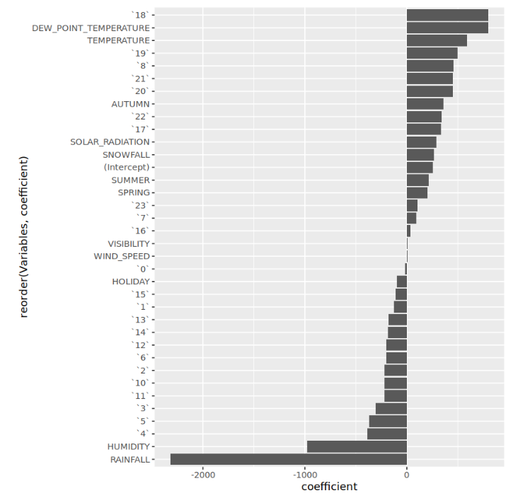
Ranked Coefficients
The number of “18” represents 6:00 pm: This time has the highest positive correlation with bike demand, likely due to being around rush hour and also when a lot of people are off work, when the temperature is not as hot as mid day, and there is still day light out.
Temperature dictates how comfortable people are riding, so it commands a top spot as well.
People clearly don’t like riding in the rain or when it’s humid out, so those factors have the strongest negative correlation with bike rentals.

Slide 28
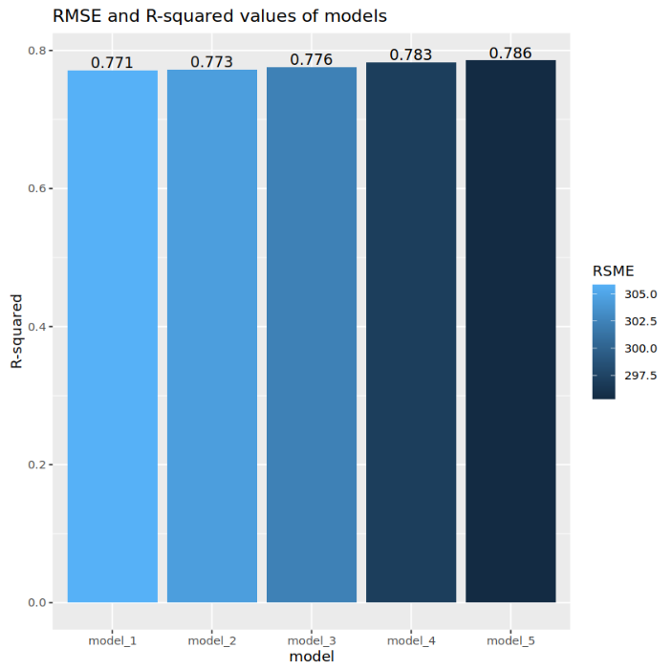
Model Evaluation
Five different models are built:
Added polynomial terms
Added interaction terms
Added regularization terms
Experiment to search for improved models

Slide 29
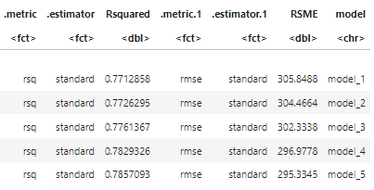
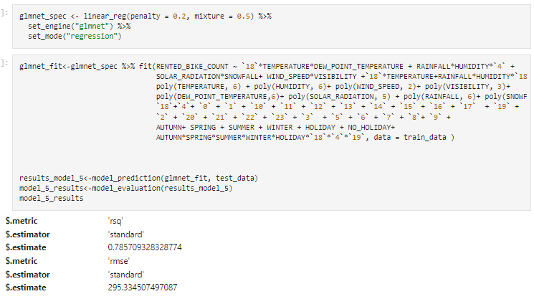
Best Performing Model
Model 5:
RMSE of 295
R-squared of 0.79
Code and output for model 5 →

Slide 30
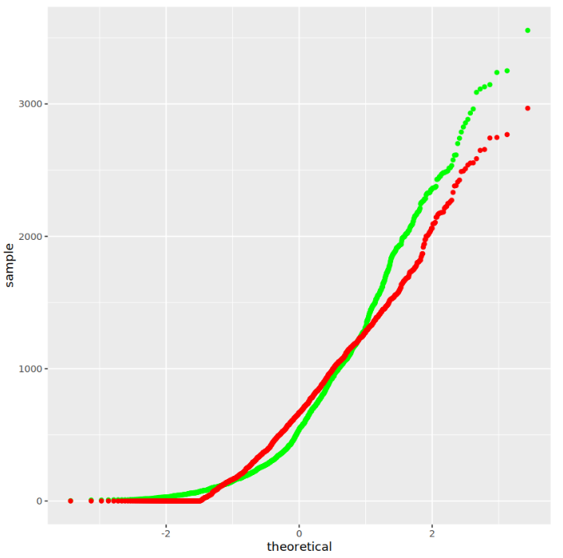
Q-Q Plot of the Best Model
This plot shows the distribution difference between the predictions generated by my best model and the true values on the test dataset

Slide 31

Dashboard

Slide 32
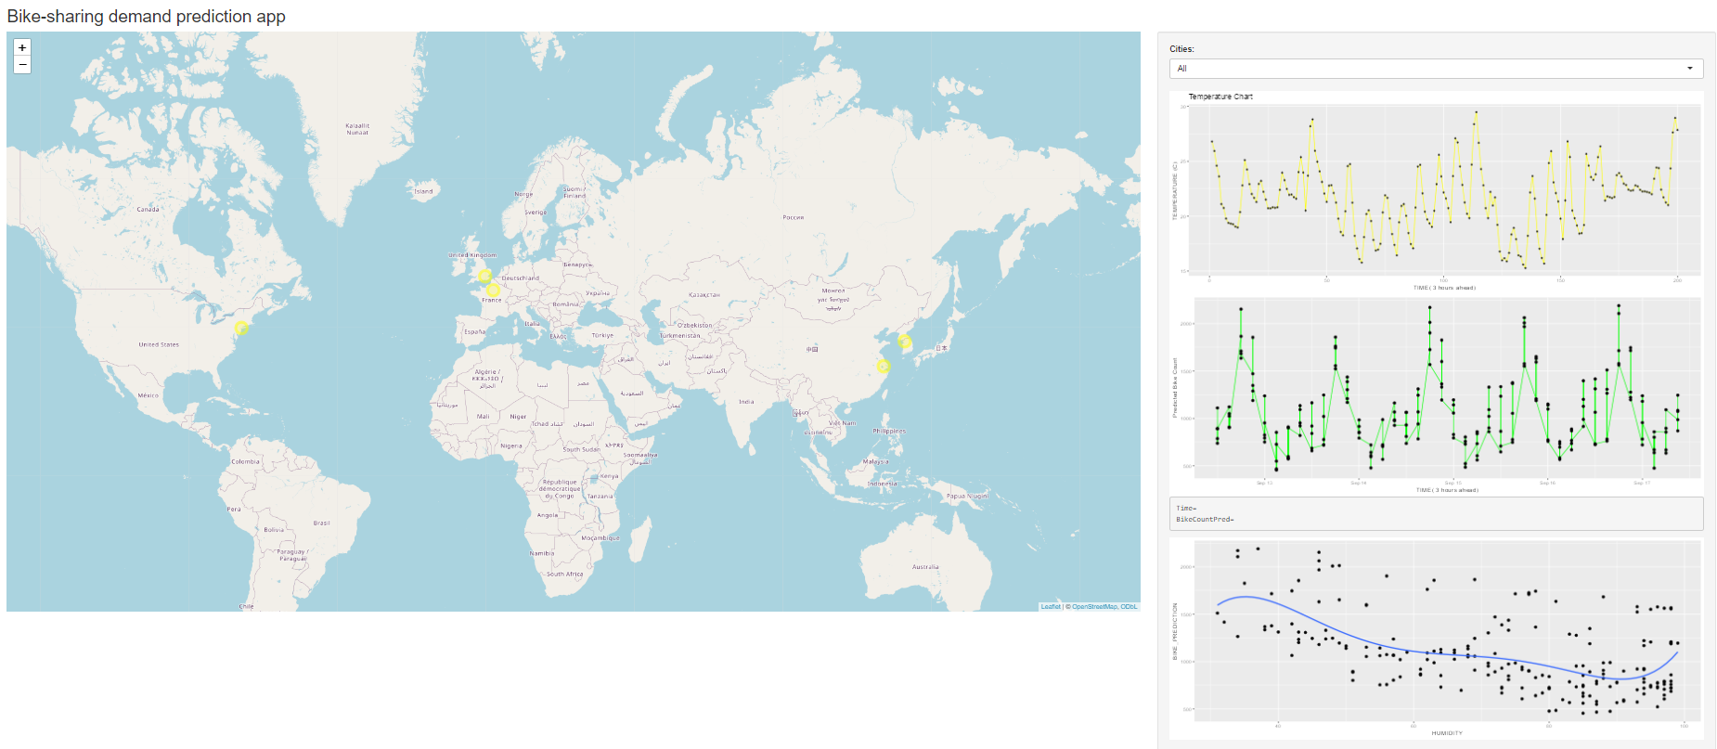
Cities’ Maximum Bike Sharing Prediction
Data is based on 9/12/2023 – 9/17/2023.
Patterns show bike numbers peaking in the evenings

Slide 33
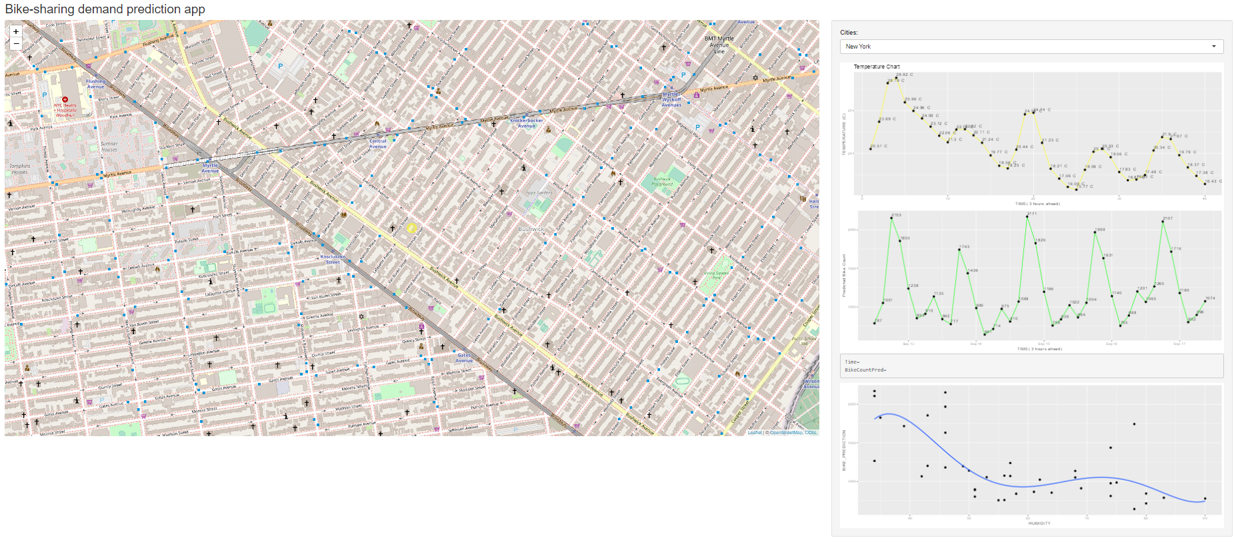
New York City Bike Demand
New York’s data prediction reflects the global data on previous slide
Temperature lowers slowly, as does humidity, and demand is predicted to remain largely the same

Slide 34
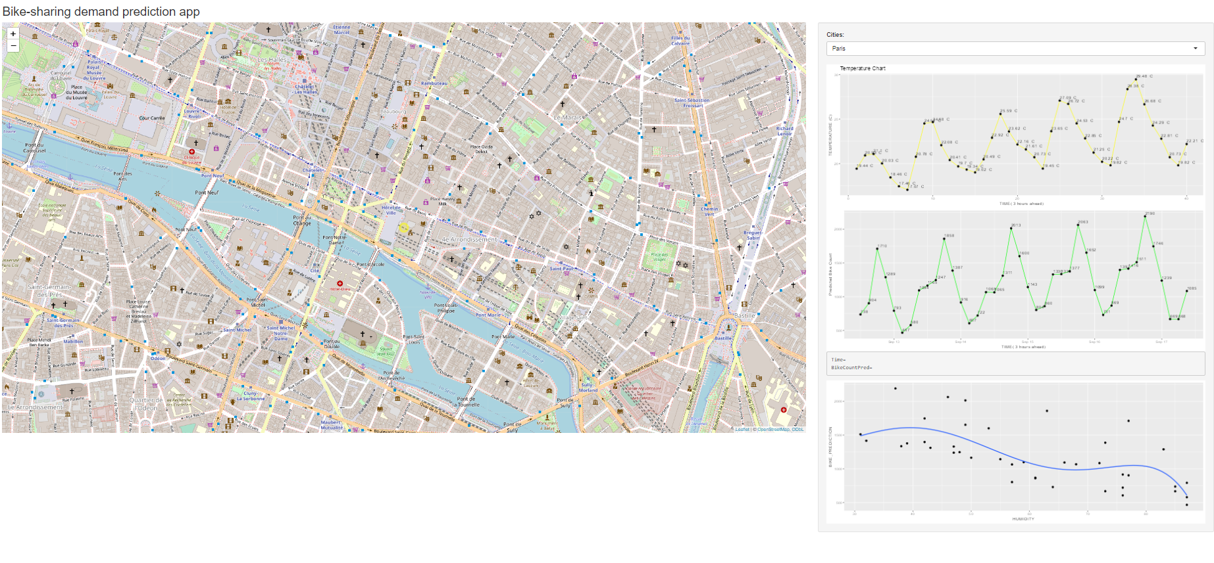
Paris Bike Demand
As the temperature rises, and humidity lowers, bike demand is expected to rise in turn.

Slide 35

Conclusion
Bike share rentals are affected by several factors including
Seasonality
Time of day
Temperature
Day of the week
Taking into consideration national holidays or other significant events could expand insight as well
Further exploration of weather variables like wind, cloudiness, etc. could reveal other insights

Slide 36
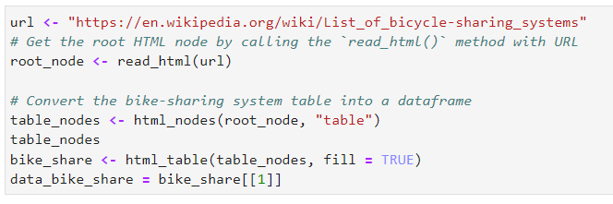
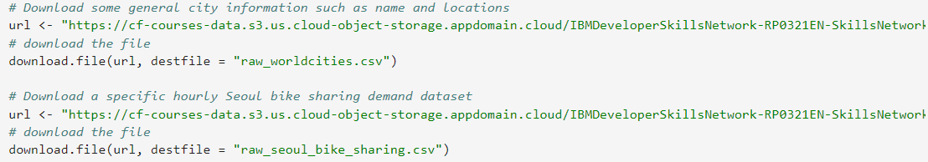
APPENDIX A: Data Collection
Webscraping code to get bike-sharing dataset
Code Snippet for Bike Demand csv file download:

Slide 37
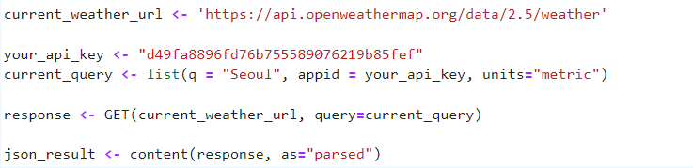
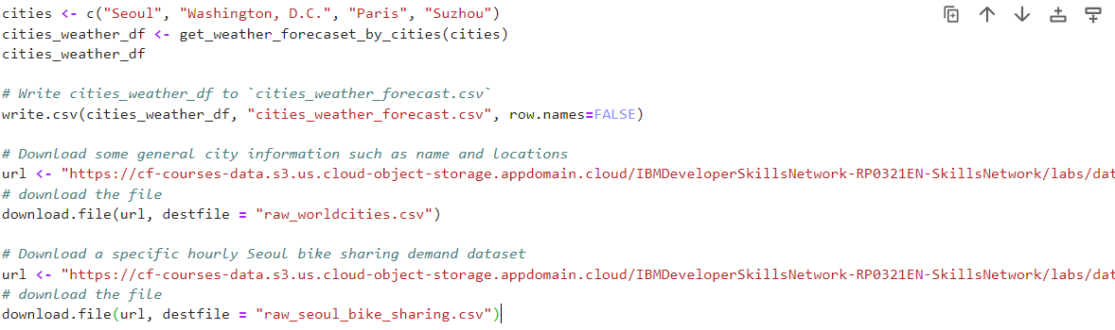
APPENDIX A: Data Collection
Open Weather Data using HTTP Requests

Slide 38
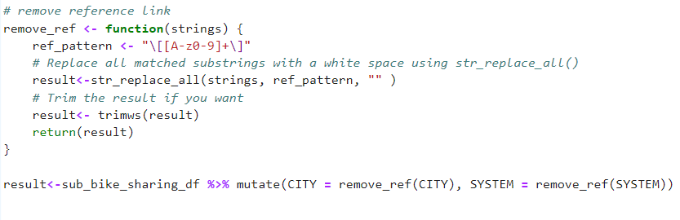
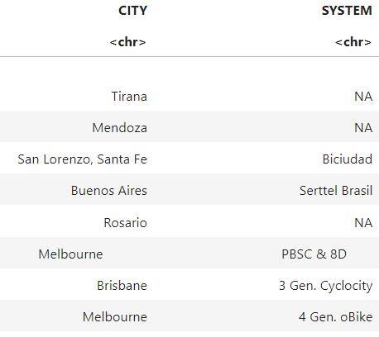
APPENDIX B: DATA WRANGLING
Regex code
Output:

Slide 39
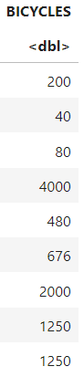
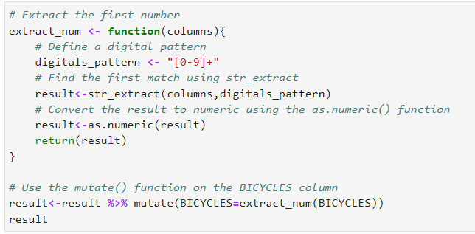
APPENDIX B: DATA WRANGLING
Missing Values Handling:
Output:

Slide 40
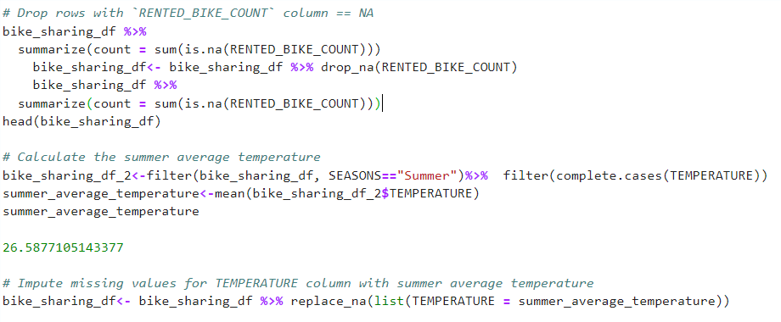
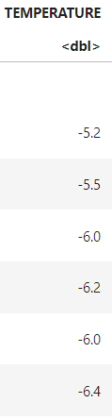
APPENDIX B: DATA WRANGLING
Missing Values Handling:
Output:

Slide 41
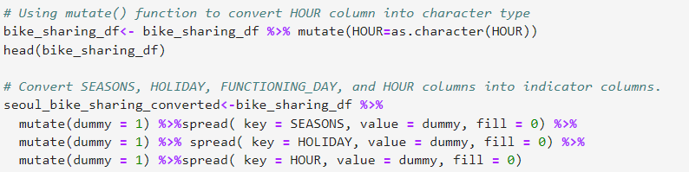
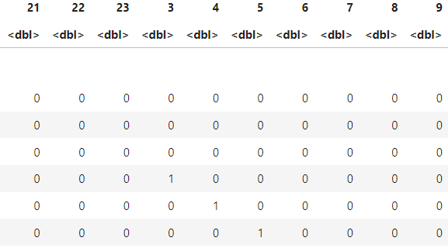
APPENDIX B: DATA WRANGLING
Generating Indicator columns:
Hour columns as categorical variables:

Slide 42
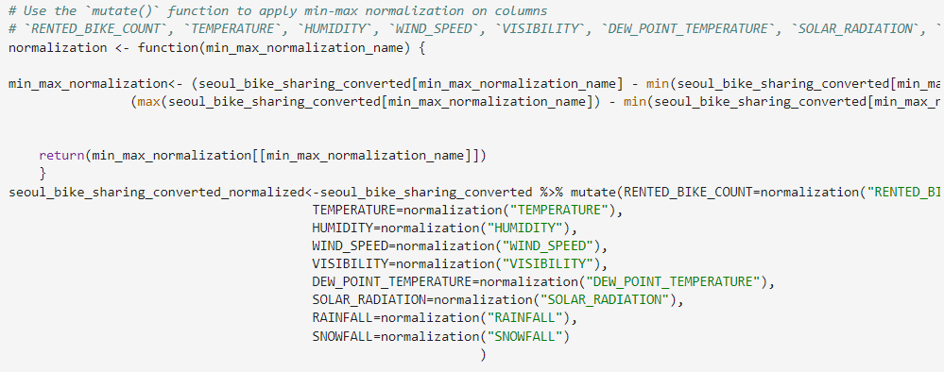
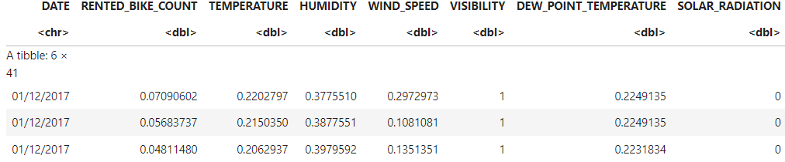
APPENDIX B: DATA WRANGLING
Normalizing Data:
Output:

Slide 43
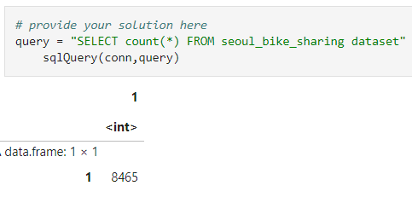
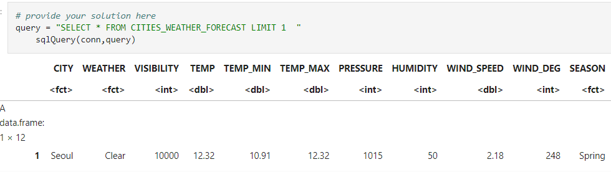
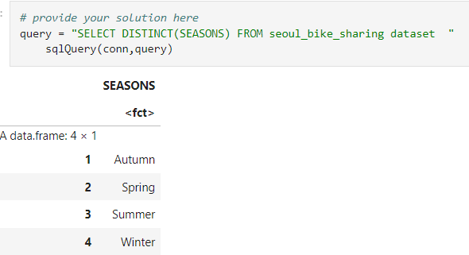
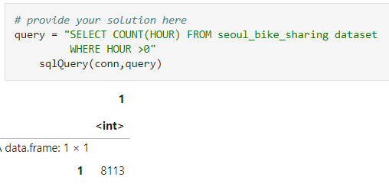
Appendix C: EPA with SQL
Record Count
Weather Outlook
Non-zero Bike Rentals
Seasons

Slide 44
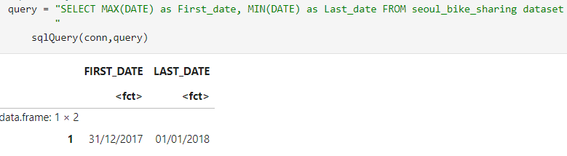
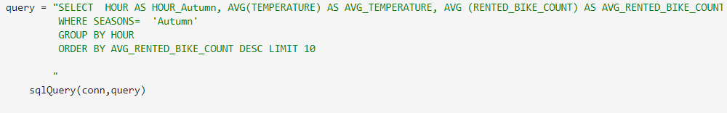
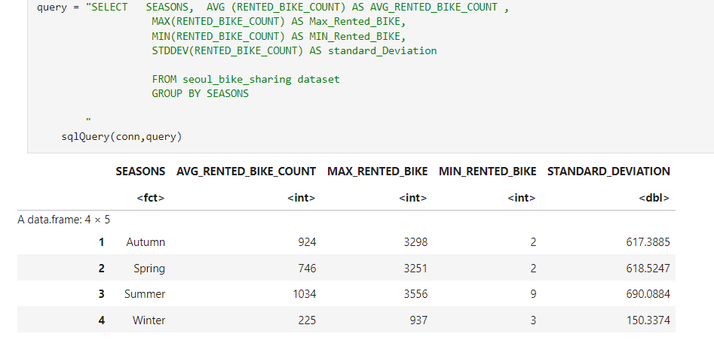
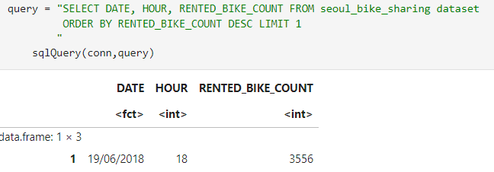
Appendix C: EPA with SQL
Data Range
Hourly Popularity and Temperature by Season
*This step was done for the 3 other seasons
All-time High

Slide 45
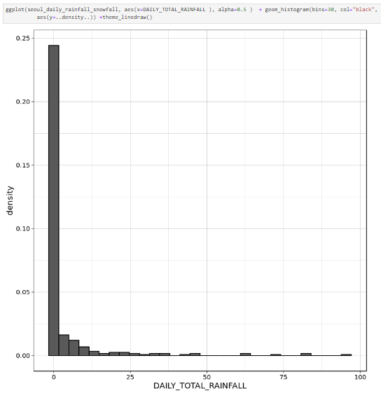
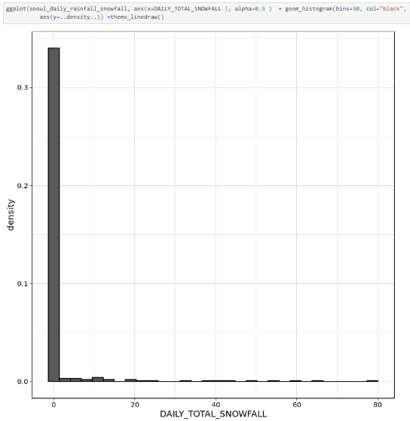
Appendix D: EPA with Other Visualizations

Slide 46
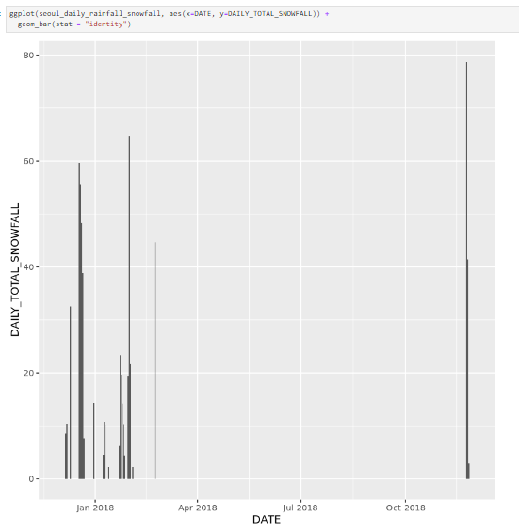
Appendix D: EPA with Other Visualizations

Slide 47
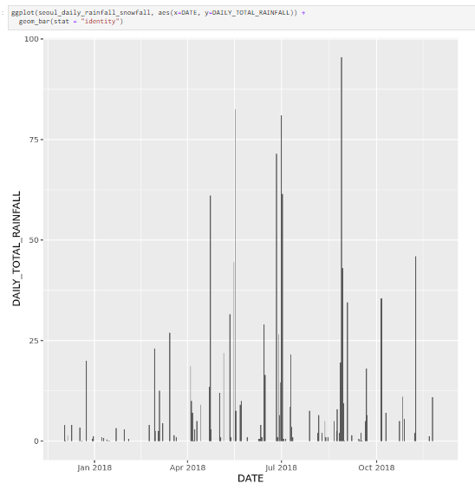
Appendix D: EPA with Other Visualizations

Slide 48

Appendix E: Regression model code

